Slide 1


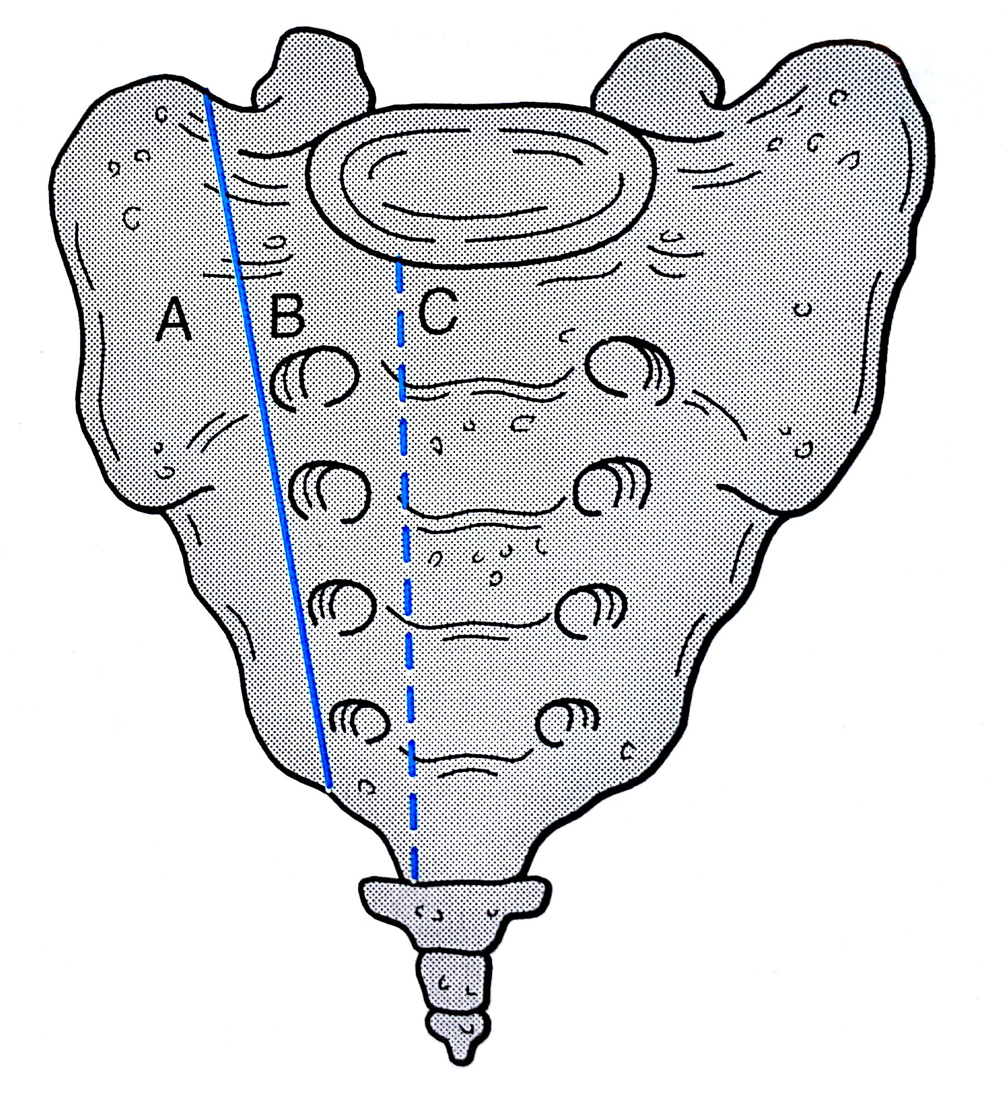
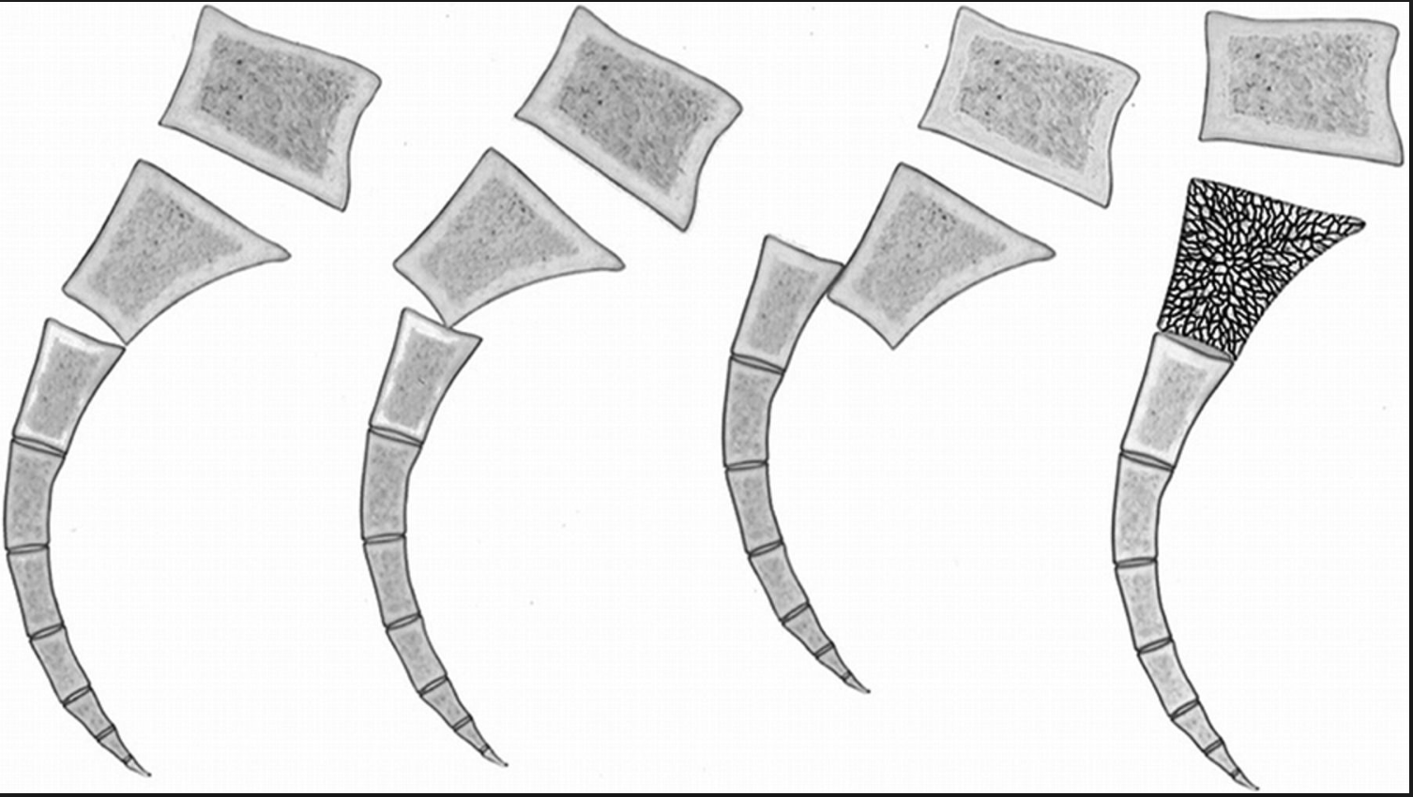
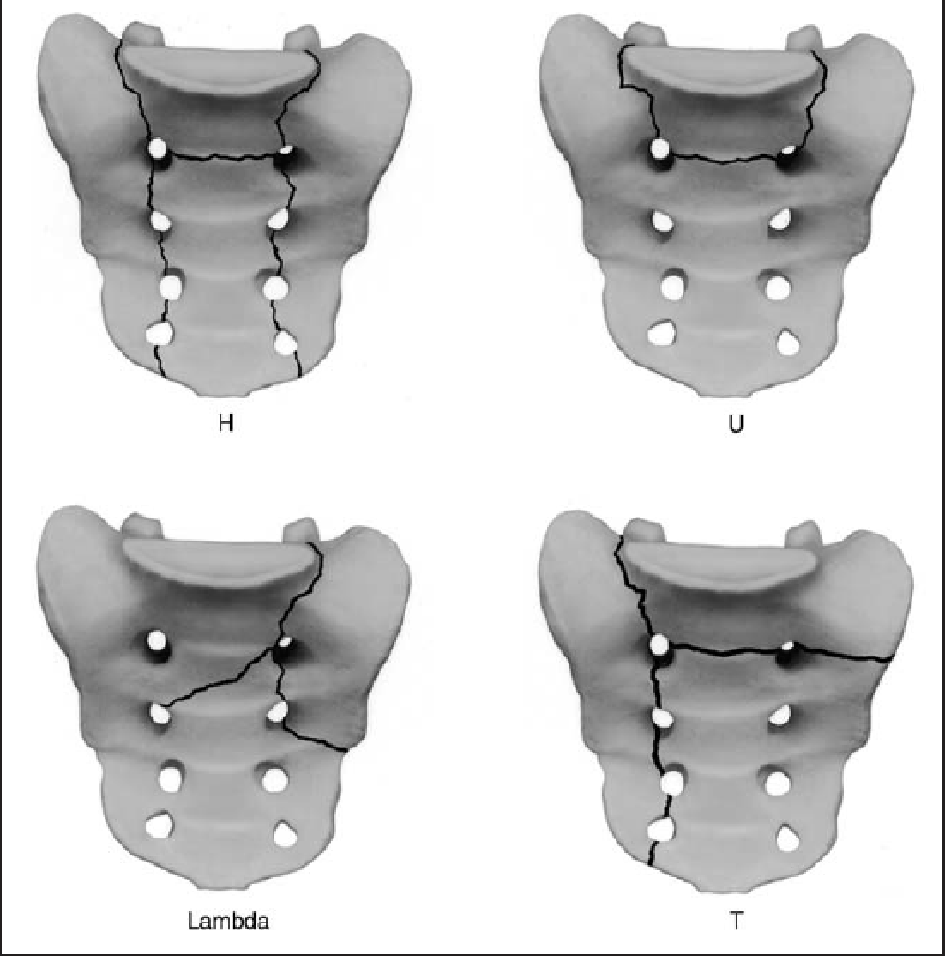
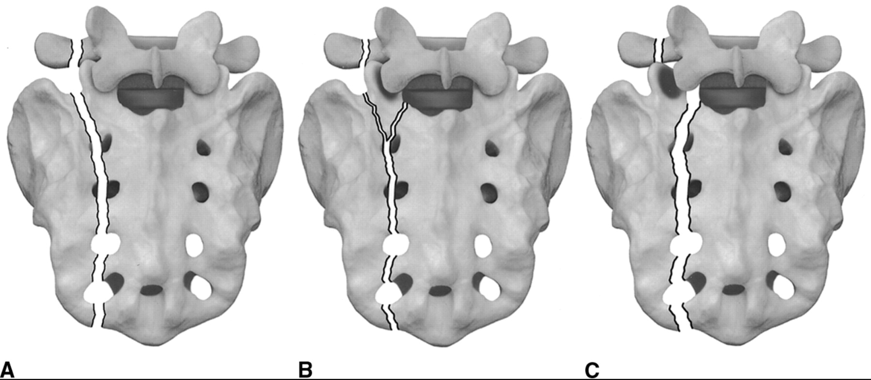
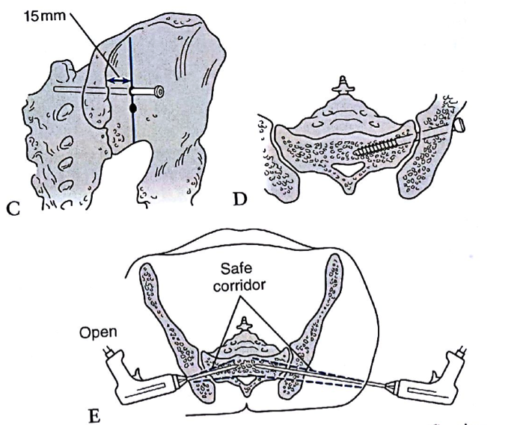
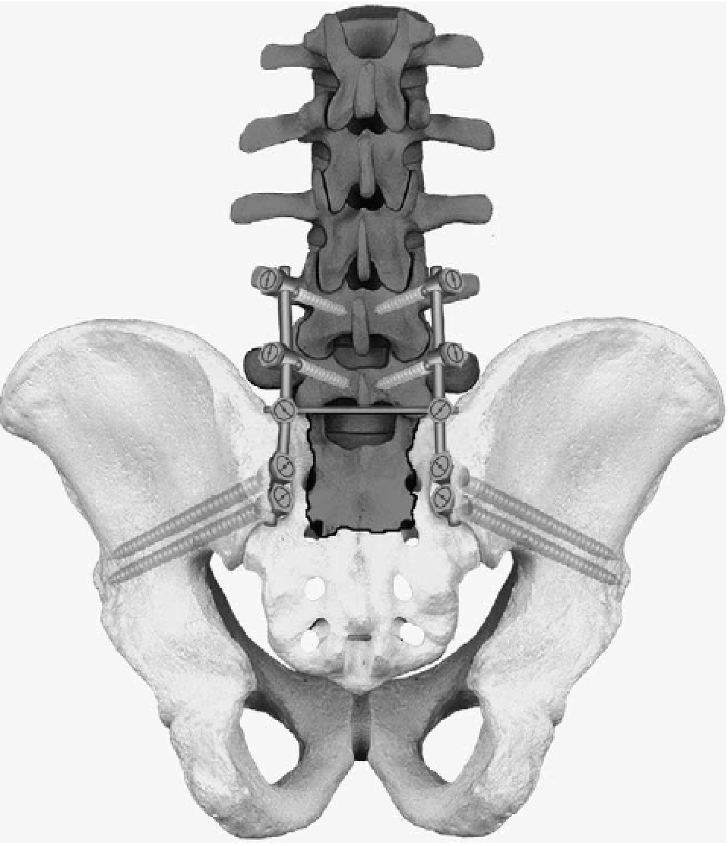
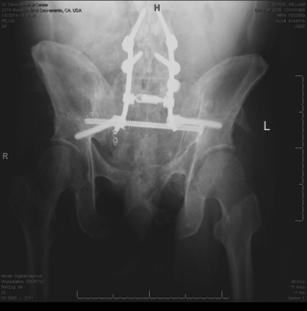
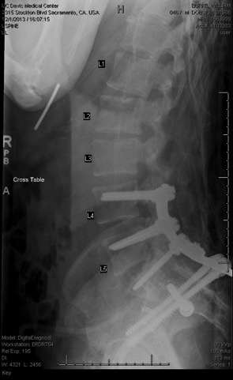
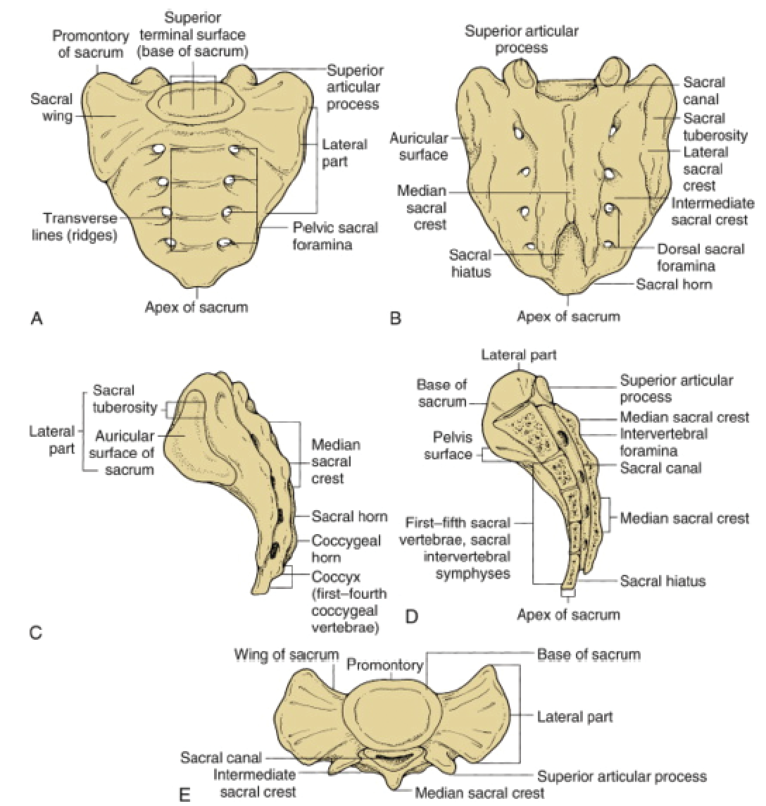
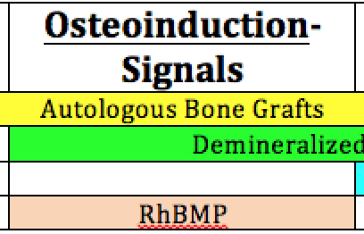
Fractures of the Sacrum
Michael A. Robbins¹ BS, Daniel T. O’Conner¹ BS, Jonathan G. Eastman¹ MD, Eric O. Klineberg¹ MD
¹Department of Orthopaedic Surgery, UC Davis School of Medicine, Sacramento, CA, USA
Introduction
Classifications³
Summary
Incidence
Rare- 0.3 per 100,000¹
Common with other injuries to pelvic ring
Mechanism
High-energy trauma – young patients
  Motor vehicle accidents
  Car versus pedestrian
  Jump/fall from height
Low-energy falls – elderly osteopenic patients
Prognosis
  Dependent on amount of neuro compression
Importance
        30% missed upon initial examination²
        polytrauma or poor visualization of sacrum
        Spinopelvic dissociation increases risk of neural injury
The sacrum is the bone that forms the connection between the spine and pelvis and allows passage of the nerve roots which extend down from cauda equina. Sacral fractures are a rare injury most commonly seen in high energy polytrauma patients. This easily missed fracture pattern requires a high index of suspicion and advanced imaging to identify most cases. Chances of neurologic injury vary by fracture pattern which correlates with Denis classification. Advances in imaging and surgical techniques have improved identification and fixation of these injury patterns. In the presence of spinopelvic dissociation, complex surgical fixation spanning from the pelvis to the spine is necessary. Prognosis depends on severity of neural deficit upon initial presentation.
Roy-Camille Classification
Denis Classification
A-6% neural injury
B-28% neural injury
C-60% neural injury
Sacral Fracture Patterns
Isler Classification- fractures relative to facets
Imaging
CT is gold standard for diagnosing sacral fracture
5 view pelvic films can be helpful and easier to obtain
Traditional inlet and outlet views have been described as 45° for inlet and outlet
Recent studies have shown 20-25° inlet and 40-60° outlet to provide superior visualization^{4,5}
  Important for intraoperative placement of ilio-sacral screws
References
Bydon M, De la Garza-Ramos R, Macki M, Desai A, Gokaslan AK, Bydon A. Incidence of sacral fractures and in-hospital postoperative complications in the United States: an analysis of 2002-2011 data. Spine. 2014;39(18):E1103-1109.
Mehta S, Auerbach JD, Born CT, Chin KR. Sacral fractures. The Journal of the American Academy of Orthopaedic Surgeons. 2006;14(12):656-665.
Mehta S, Auerbach JD, Born CT, Chin KR. Sacral fractures. The Journal of the American Academy of Orthopaedic Surgeons. 2006;14(12):656-665
Eastman JG, Chip Routt ML, Jr. Correlating preoperative imaging with intraoperative fluoroscopy in iliosacral screw placement. Journal of orthopaedics and traumatology : official journal of the Italian Society of Orthopaedics and Traumatology. 2015
Ricci WM, Mamczak C, Tynan M, Streubel P, Gardner M. Pelvic inlet and outlet radiographs redefined. The Journal of bone and joint surgery. American volume. 2010;92(10):1947-1953.
Nork SE, Jones CB, Harding SP, Mirza SK, Routt ML, Jr. Percutaneous stabilization of U-shaped sacral fractures using iliosacral screws: technique and early results. Journal of orthopaedic trauma. 2001;15(4):238-246.
Tim Pohlemann UC. Pelvic Ring. In: Thomas P Ruedi REB, Christopher G Moran, ed. AO Principles of Fracture Management. Vol 2 - Specific Fractures. Second Expanded Edition ed. Switzerland, Clavadelerstrasse 8, CH-7207: AO Pubishing; 2007:697-717
Anatomy
5 fused vertebrae
• Makes up posterior portion of pelvic ring
• Transmits body weight from spine to
pelvis
• Nerves exit through sacral foramina
• Ala (wing) is common site for sacral fractures
• Segments fuse at puberty
Surgical Fixation
Very few sacral fractures can be managed nonoperatively, but most can be fixed using either ilio-sacral screw placement in simple fracture patterns or triangular osteosynthesis in spinoplevic dissocaition fracture patterns.^{6,7} Surgical stabilization also allow earlier ambulation after injury, improving recovery times.²
Contacts/Acknowledgments
Iliosacral screw placement
Triangular Osteosynthesis
Case example showing AP and Saggital view with both iliosacral screw and triangular osteosynthesis
Thank you to my mentors Dr. Klineberg and Dr Eastman and my colleague D. O’Conner for their contributions to this work.

